Slide 1
THESE ARE NOT SYMBOLS
WEDDING GIFTS FROM GURU

Slide 2
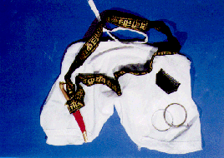

Gifts from Guru
The Kanga, the Kesh, the Kara, the Kirpan, the Kachha, were all delicate gifts of love and beauty to the Khalsa from a man who desired nothing for himself, but everything for the Khalsa

Slide 3
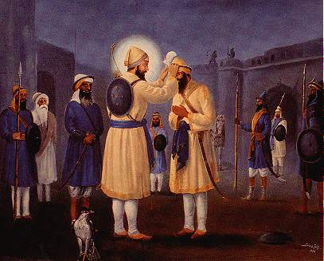
“If thou art zealous of playing the game of love, then enter upon my path with thy head on thy palm.”
It was out of such love that these gifts were presented to the Khalsa and not out of any attempts to carve out soldiers
These gifts were from a Guru who totally surrendered everything for the cause and unique love of the Khalsa.

Slide 4
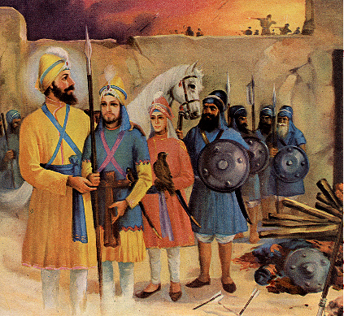
No love without total commitment
When there is total love, there is action, there is sacrifice, is there not?
The love of the Guru for the Khalsa was not the result of mental vibrations.
In his life, there was no gap between love and action, as there is between our thinking and action.
Sending sahibzadas for
Battle at chamkaur

Slide 5


No love without total commitment
.
It is only we who want to be one sided in our love and make claims of loving the Guru in our ideals.
Consequently we reason out that we don’t have to express our love for Him in action, in the Kesh.
But can there be love without total commitment and action? No.

Slide 6
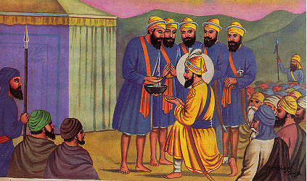

Proud to wear the brand name of Guru Gobind Singh.
A Briton was asked, “Why do you wear a turban?
Is it not enough for you to practice the philosophy of Guru Gobind Singh in your social and personal life?”
He replied, The people accept me as the son of Guru Gobind Singh.
Is it not enough reason to wear the turban?”
“

Slide 7
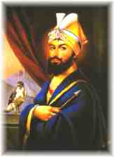
Proud to wear the brand name of Guru Gobind Singh.
This can be understood when we see many people, particularly the youth, having clothes and shoes bearing brand names.
The Sikhs are similarly proud to wear the brand name of Guru Gobind Singh.

Slide 8
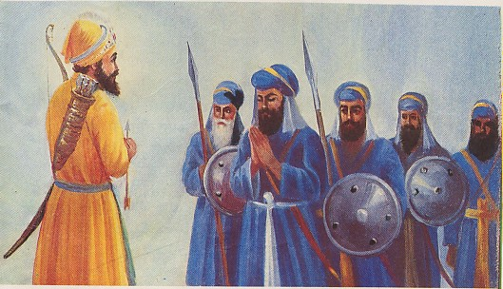
Love of the Guru for the Khalsa in sarabloh Granth
The total love of the Guru for the Khalsa becomes apparent in the book titled the Sarbloh, where, He becomes one with the Khalsa and portrays the Khalsa as his highest love:
Khalsa is the breath of my body,
Khalsa is the very soul of my life.
Khalsa is my object of meditation.
Khalsa gives me intellect and wisdom,

Slide 9
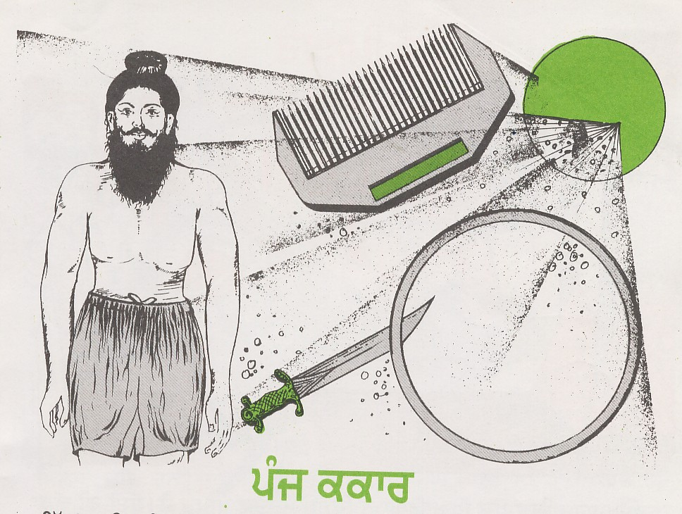
Beauty of the gifts
The mind that lives the Sikh way of life can know what is the beauty of the gifts the Guru gave to us.
The 5 ornaments that we wear are the gifts, from the Guru whose whole family was sacrificed for the total love of the Khalsa.
Could such a Guru be looking for practical utilities of an animal existence?
He was not the person to endow us with gifts of mere practical value, but gifts of love, which knew no questioning, no bartering, no deals, and no betraying.

Slide 10
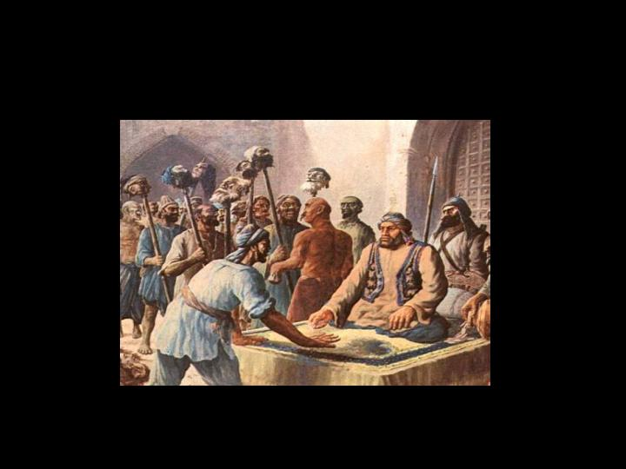
His was a total sacrifice and a total love, in both thought and action, for the happiness of the Khalsa.
These gifts had their pangs of birth in a sea of human blood.
It was not out of any practical benefit that the evil genius of the Mughal government announced awards for the hair of the Sikhs.
It was because they knew that, the Khalsa, deprived of these gifts (the Guru’s love), would disintegrate.
Mughal government announced awards for the hair of the Sikhs

Slide 11
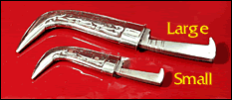
The Kirpan is a gift from Guru Gobind Singh Ji to the Khalsa.
It is not to be judged and measured as a weapon of war or peace, it is a gift activated by the love of the Guru.
Even a whole army of bodyguards or the best police state in the world cannot make it redundant.
It shall always remain attached to me. The sword is the love wherein the Guru resides.
Kirpan is a gift from Guru Gobind Singh Ji

Slide 12
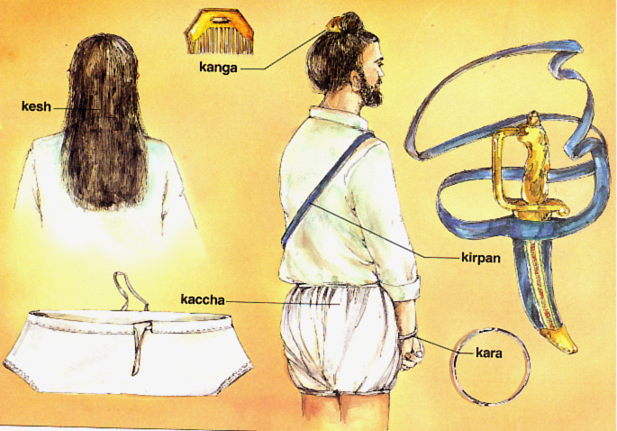
You say it is inconvenient, frustrating, and impractical to grow our hair long.
But more frustrating is an existence of no inspiration and no effort.
Our superficial hollow life is no way less discouraging.
The day to day fragmentary living, the everyday struggle for food, the daily pain, suffering, distress, torments, and headaches are in no way less discomforting.
But in spite of all this, do we cease to exist?

Slide 13
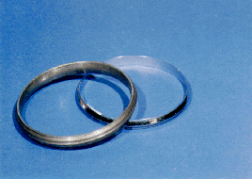
The Kara has to be received by us as a present with the message, “Guru loves me. He made me His own.”
You want to question the utility of the iron bangle of the Guru, but not of the gold bangle which is so much in vogue at Sikh engagement ceremonies today.
You are ready to discard the Guru’s bangle for the yellow metal.
Kara --“Guru loves me. He made me His own.”

Slide 14
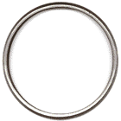
Kara comes to us as a manifestation of His love and benediction.
From the day we put it on our wrists, the Kara was forever ours; no one could separate it from a Sikh.
And we still want to find reasons for wearing it.

Slide 15
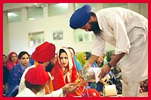
wedding gifts
Do not make our presents into dead symbols, they are the gorgeous ornaments of the living.
We are the “Wedded devotees” of God.
They are the wedding gifts from our Bridegroom.
He gave all of them to us and they are God-sent, imperishable, indispensable, and indestructible.

Slide 16
You may object and say all this is irrational, unacceptable, superstitious, and fatalistic.
But the waves of pure love always have their own logic, irrationality and fatalism.
I love the Guru’s irrationality- if you want to call it so. “To serve them pleases me.”
I don’t have the courage to reject such devotion.

Slide 17
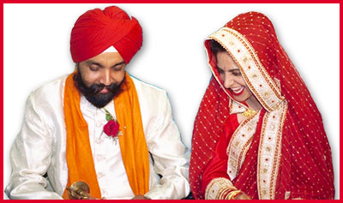
Does a would-be-wife question the intrinsic value of the engagement ring, she is gifted by her husband?
No, never, even if it is made of copper or a shell.

Slide 18
Today, you want to discard these gifts, because gold has more value.
The choice is yours, the consequences are yours.
The bliss of love is yours, the solitude of separation is yours.
These gifts are not to be stored in the darkness of the cellars; drink deep into them, if you want to live in spiritual grandeur.

Slide 19
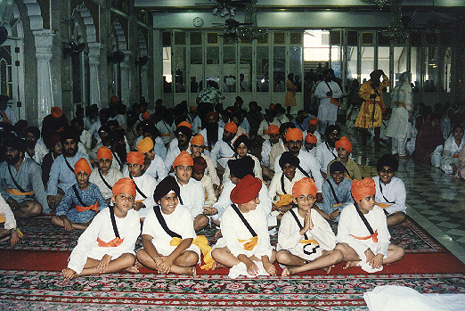
The head of a Sikh, (the Kesh of a Singh) having been once offered to and accepted by the Guru, is in unceasing trust with Him.
It is, therefore, imperative for a Sikh to carry his head high and not to bow it before a mortal barber.
I shall only bend and bow before the Guru.
The head of a Sikh, (the Kesh of a Singh) having been once offered to and accepted by the Guru, is in unceasing trust with Him

Slide 20
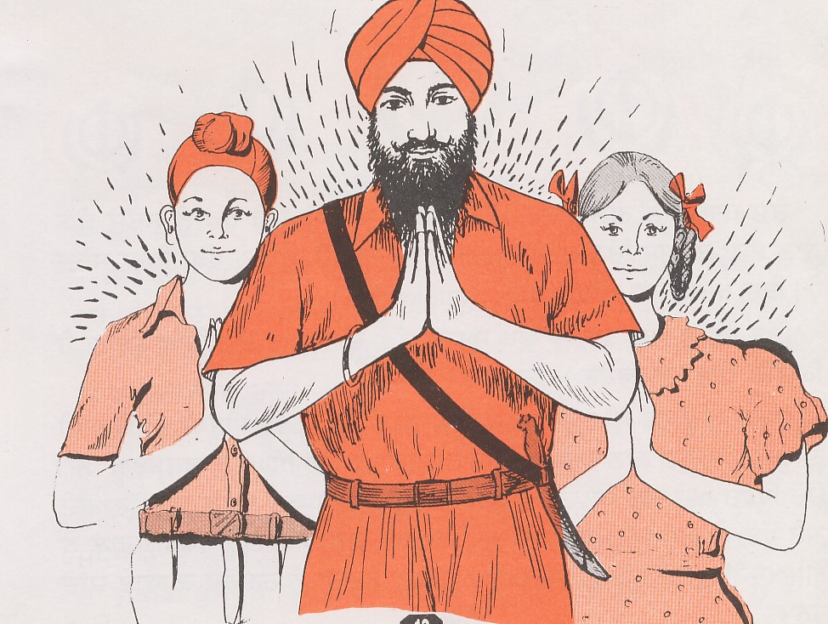
Every day we recite in our prayer “Nanak das sada kurbani.” “Nanak thy servant is ever a sacrifice to Thee.”
But instead we sacrifice our 5 K’s.
Shocking is our spirit of sacrifice.
Are we the worthy inheritors of this heritage?
After drawing on his blood, now by discarding our 5 K’s, we want to stab him in the back!

Slide 21
The head of a Sikh, (the Kesh of a Singh) having been once offered to and accepted by the Guru, is in unceasing trust with Him.
It is, therefore, imperative for a Sikh to carry his head high and not to bow it before a mortal barber.
I shall only bend and bow before the Guru.
The head of a Sikh, (the Kesh of a Singh) having been once offered to and accepted by the Guru, is in unceasing trust with Him

Slide 22
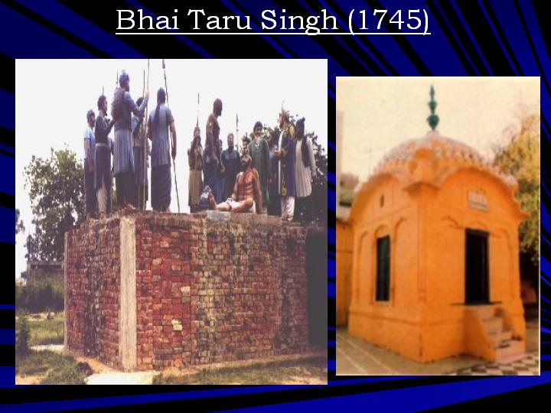
one kilometer from the Lahore railway station stands a gurdwara, sacred to the Sikhs in the loving memory of Bhai Taru Singh Ji.
It bears the name of Shahid Ganj, the Abode of Martyrs.
The governor said to him, “Somehow my heart does not permit me to have you killed, but you must cut and present me your tress-knot.”
Shahid Ganj, the Abode of Martyrs

Slide 23
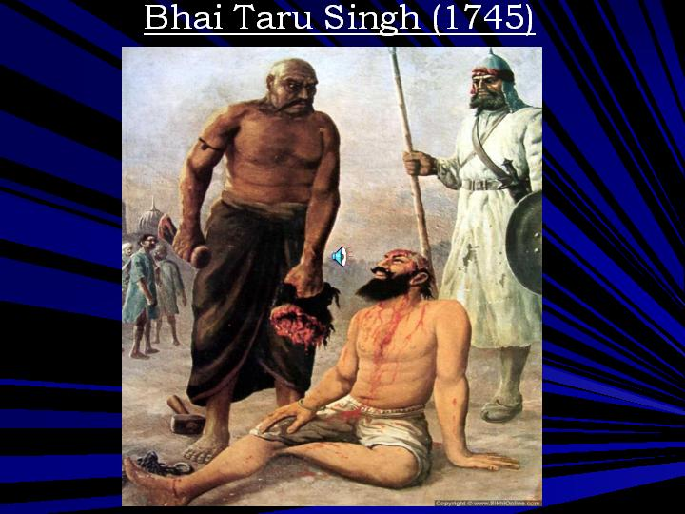
Taru Singh replied, “The Sikh and his hair are one. I will be pleased to give you more than you ask me, my head with my tress-knot. These hair are the eternal gift of love, they cannot be separated from a Singh’s head without separating his head.”
Hearing the offer of a high office and an estate for his tress-knot, the Singh continued, “Neither my life, nor my hair are for bargaining in your court which views beauty, life, and religion in weights of gold.
.”
The value and beauty of our hair cannot be measured in terms of luxuries and jagirs

Slide 24
Thakur Rabindranth Tagore, a Nobel laureate, has beautifully sung of this episode: “More than asked for.”
if Bhai Taru Singh had looked for practical utility, significance and relevance, wouldn’t he have exchanged his hair for a jagir, for beautiful women, and the power he was offered?
But all these he regarded as worthless when he weighed them with his way of life.
If the hair were mere symbols for him, would he have staked his life for them.

Slide 25

Love is not to be hooked in the net of intelligence; if you use knowledge to grasp love, it will die as a fish does out of water.

Slide 26
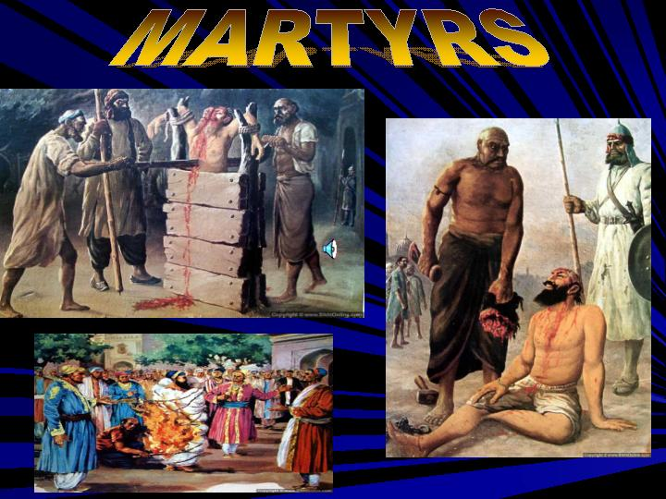
We find not only Bhai Taru Singh, but a whole galaxy of martyrs in our History, all playing with their lives, which appears to us so irrational and fatalistic.

Slide 27
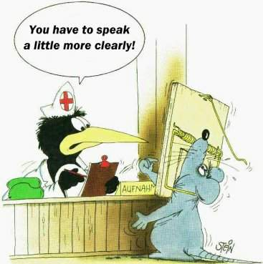
Knowledge is like a kerosene lamp on a dark night, it can illuminate only so long as it has fuel.
Life is much vaster and deeper, it cannot be lived with the aid of an extinguishable lamp.
Knowledge is essential to everyday existence, as money is to buy your food, but it cannot grasp the reality of love, of God, of living.

Slide 28
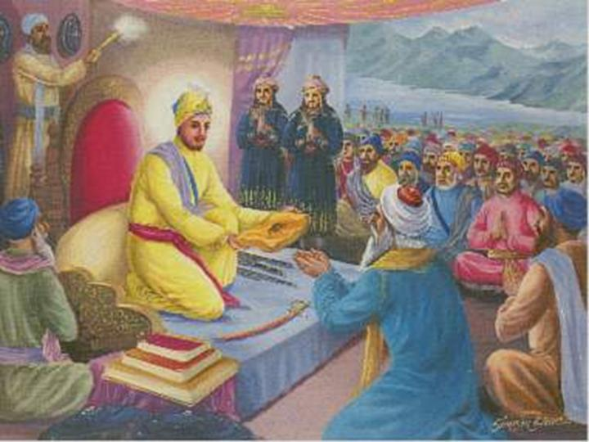
After the victory of the battle of Bhangani, Guru Gobind Singh Ji blessed Pir Budhu Shah with no treasures and no elephants for his services, as was the custom of that time.
However, the Guru gave him the gift of a kirpan and a comb with some broken hair of his.
This very ‘jewelry’, he presented to all of us, in spite of the fact that our lives were not wrought in the furnace of sacrifice; a jewelry which no craftsman, no intellectual, no jeweler is capable of imitating.
PIR Budhu shah
asked for hair and
not treasures after
Sacrificing sons in
the battle of Bhangani

Slide 29
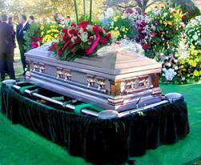
living monument
ask not from me, the significance and the value of our tress-knots, for I am incapable of describing it.
In our mystical tress-knots, insipid mankind is inspired.
People build monuments for the dead, you want to uproot the living monument the Guru gave to you.
If you want it to disintegrate you may, but you shall forever be buried under it.

Slide 30
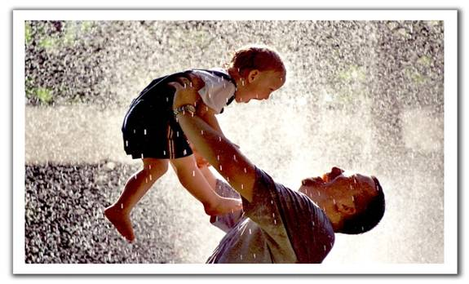
Beauty and the love can never be dissected
The beauty and the love can never be dissected and summed up.
What would the cuckoo’s song mean to you, if you want to take down its notations and analyze them?
What would your mother’s love be for you if you want to know her by analysis

Slide 31
His gifts of love
In the end, let me conclude that the Kesh, the Kachha, the Kara, the Kanga, the Kirpan, are the gifts, chiseled out for the Khalsa by the Divine Artist.
These are the gifts endowed to us forever, by the Divine Bridegroom, on the day of our ‘marriage’ to Him on Baisakhi in 1699.
We will carry His gifts of love, in honor, purity, and splendors.
Our love will blossom in all climes, in all times and in all continents.

